Slide 1

Übung cellular automata
Simon Gisler, Woche 4

Slide 2

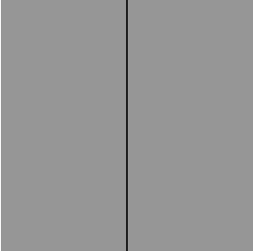

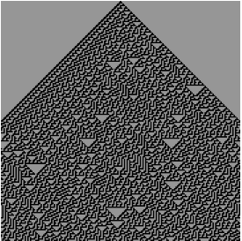
Wolfram 1d
10111100
10001100
1001110
10011110

Slide 3
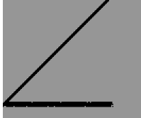
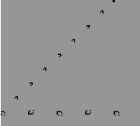
Game of Life - Fails

Slide 4
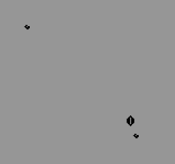
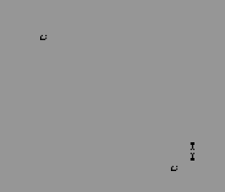
Game of life – Win!

